Slide 1

EXPERITIAL LEARNING OF AI & DS
IMAGE CAPTION GENERATOR
Automatically Generating Captions for Images Using Deep Learning
Group: 4
Presented by:
Sub-Group: 15

Slide 2
TEAM DETAILS
Name | Cranes Registration Number
Soumya Ranjan Das | CL2025010601910440
Sachin Kumar Singh | CL20250106019272103
Vinay Prabhakar | CL2025010601870917
Priyanshu Kumar Bhadani | CL2025010601886345

Slide 3
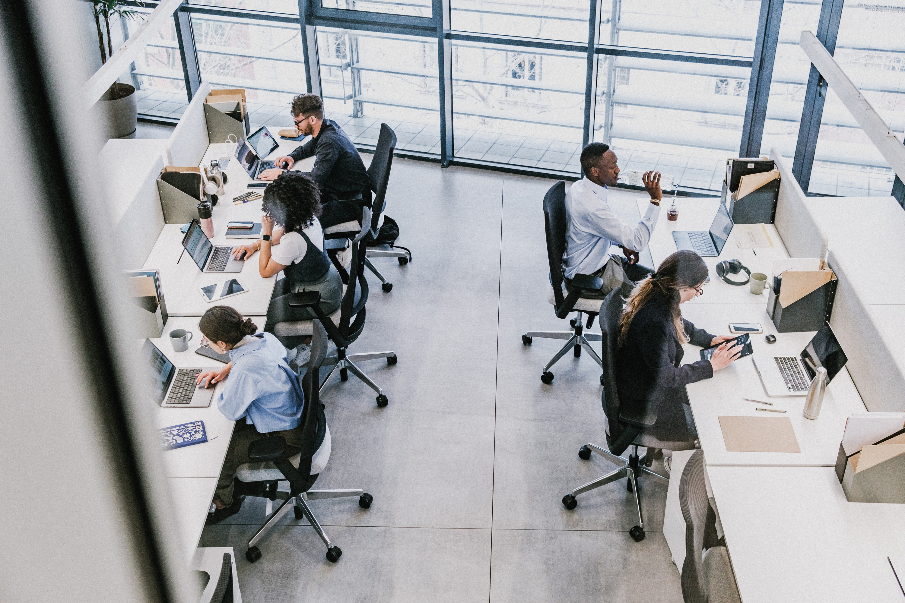
Introduction
What is it?:
A system that generates descriptive captions for images.
Why it matters:
Enhances accessibility, automates content tagging, and supports AI-driven applications.
Objective:
Build a model combining computer vision and natural language processing.

Slide 4
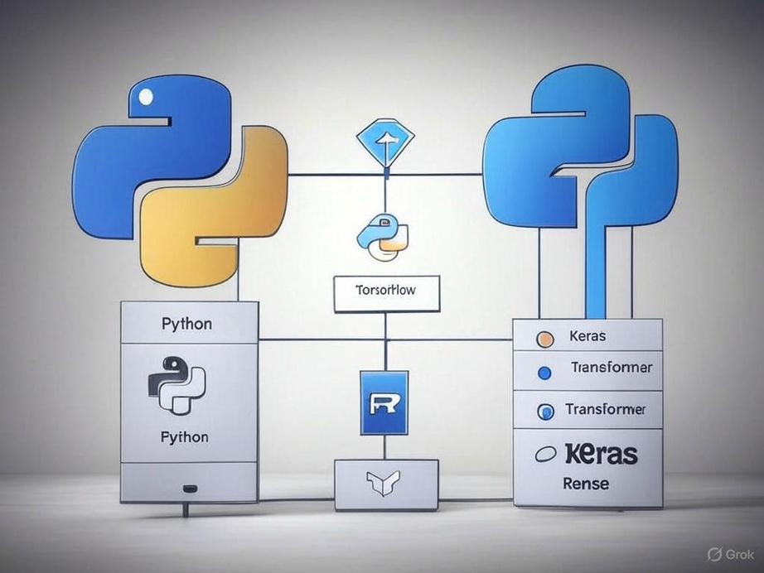
Project Overview
Technologies Used:
Python
TensorFlow / Keras
Pre-trained CNN (ResNet)
Transformer for caption generation
Dataset: Flickr8k
Approach: Encoder-Decoder architecture
Tensorflow

Slide 5
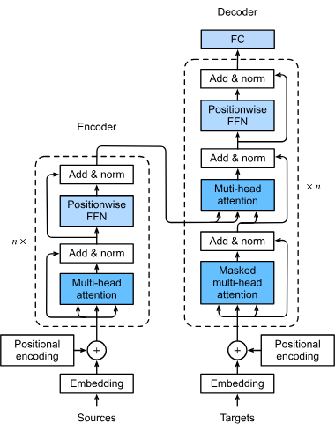
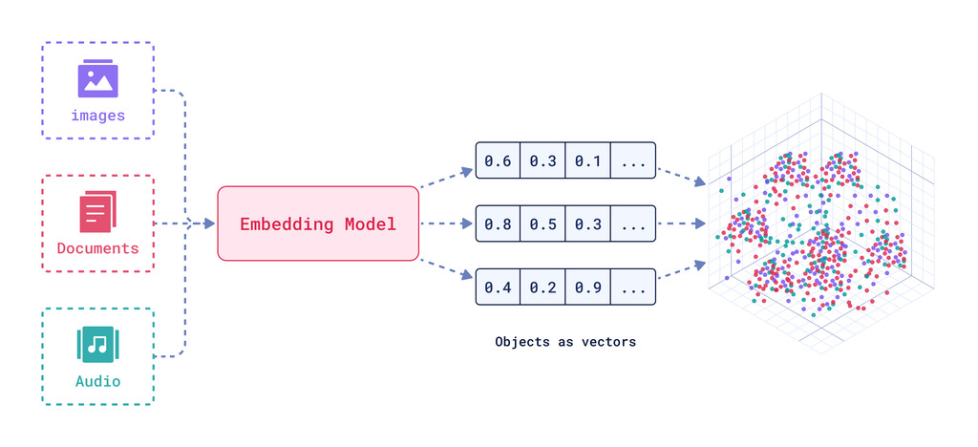
Transformers Architecture

Slide 6
Attention is all you Need !
"The tiger jumped out of a tree to get a drink because it was thirsty."
Self-attention helps to determine relationships between different words and phrases in sentences.

Slide 7
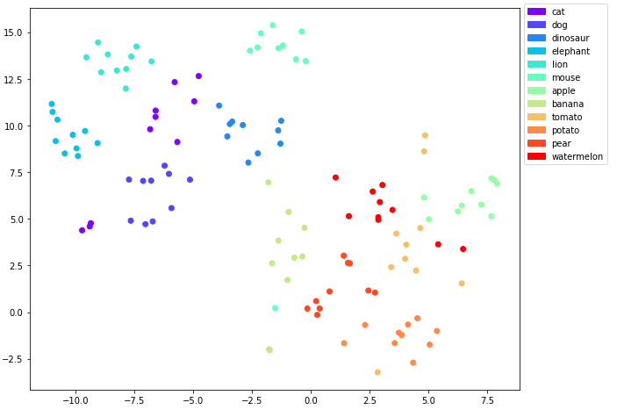
Visualization of Embedding Space

Slide 8
Methodology
Data Preprocessing: Load images and captions, tokenize text.
Feature Extraction: Use a pre-trained CNN to extract image features.
Model Design: Combine CNN (encoder) with Transformer (decoder).
Training: Optimize using sparse categorical cross-entropy loss.
Evaluation: BLEU score for caption quality.

Slide 9
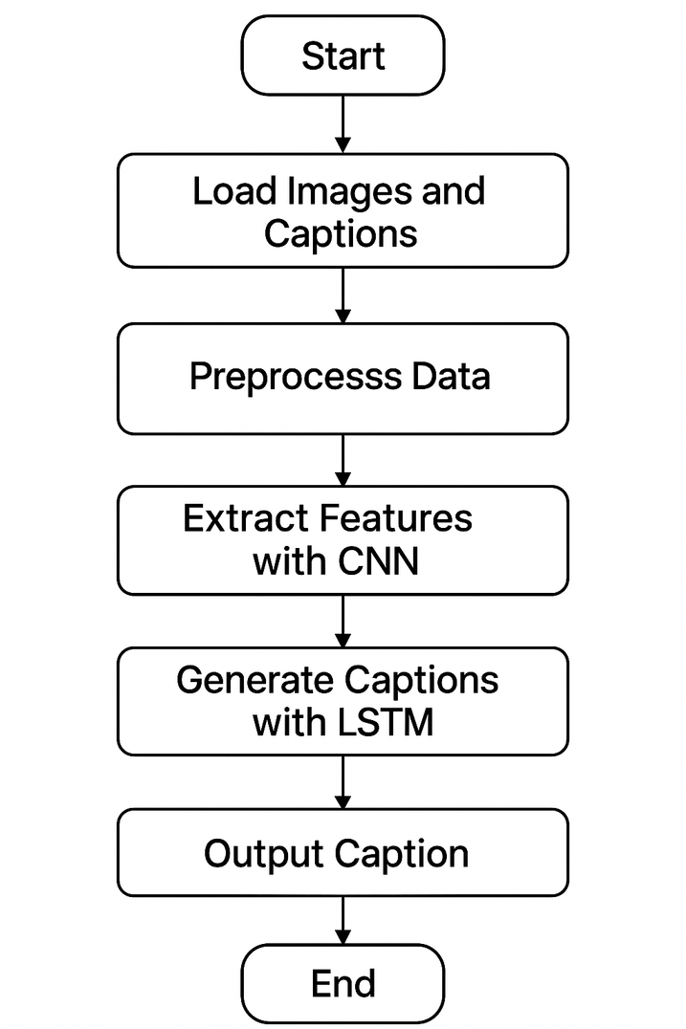
Model Architecture
Diagram (Simplified):
Input Image → CNN (e.g., ResNet) → Feature Vector
Feature Vector → RNN/LSTM/Transformer → Caption Output
Key Components:
CNN: Extracts spatial features from images.
RNN/Transformer: Generates sequential text output.
Transformers

Slide 10
.
Implementation Details
Code Highlights (Assumed):
Loading pre-trained CNN: ResNet50(weights='imagenet')
Text tokenization: Tokenizer from Keras
Training loop: Batch processing with GPU acceleration
Libraries: NumPy, Pandas, Matplotlib, Keras/TensorFlow

Slide 11
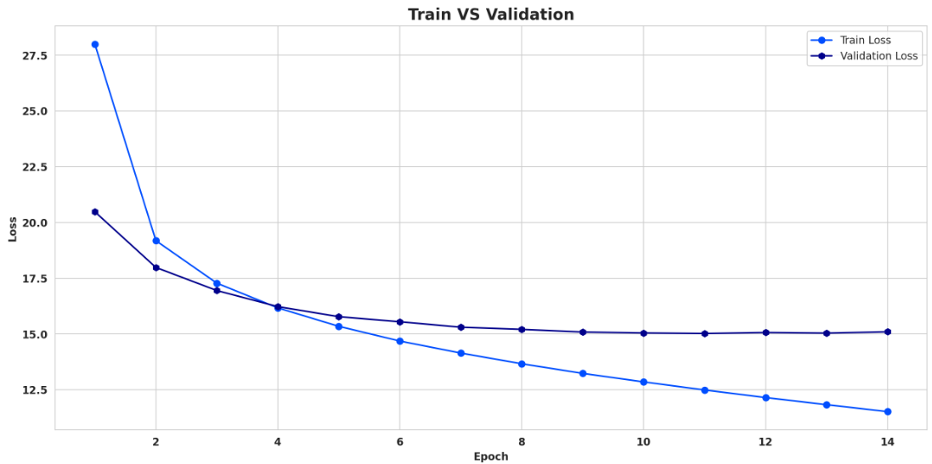
Train & Validation Loss

Slide 12
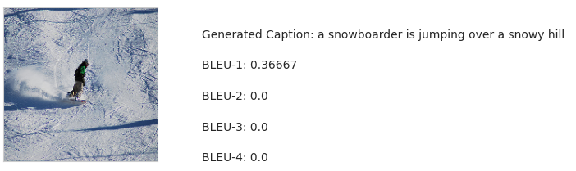
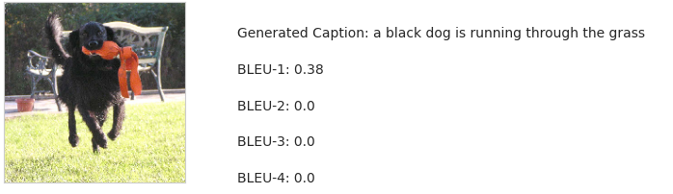
Results

Slide 13
Applications
Real-World Uses:
Social Media Content Automation: Automatically generates captions for images on platforms like Instagram and X(Twitter), saving time and enhancing engagement (e.g., "A cozy sweater perfect for winter!").
Assistive Technology for Visually Impaired: Provides real-time image descriptions for accessibility, integrable with screen readers (e.g., "A group of friends hiking in a forest").
Image Search Enhancement: Improves search accuracy by adding textual descriptions to images (e.g., "sunset over a beach" for better indexing).
Future Potential: Multilingual captions, real-time processing

Slide 14
Conclusion
Summary:
Built an image caption generator using deep learning with Python, TensorFlow/Keras, ResNet, and Transformer. It effectively describes images from the Flickr8k dataset via an encoder-decoder model.
Key Takeaways:
Integrates ResNet for image processing and Transformer for text generation. Successfully bridges vision and language for accurate captioning.
Next Steps:
Enhance accuracy through fine-tuning and optimization. Expand dataset and deploy as a user-friendly app for wider use.

Slide 15
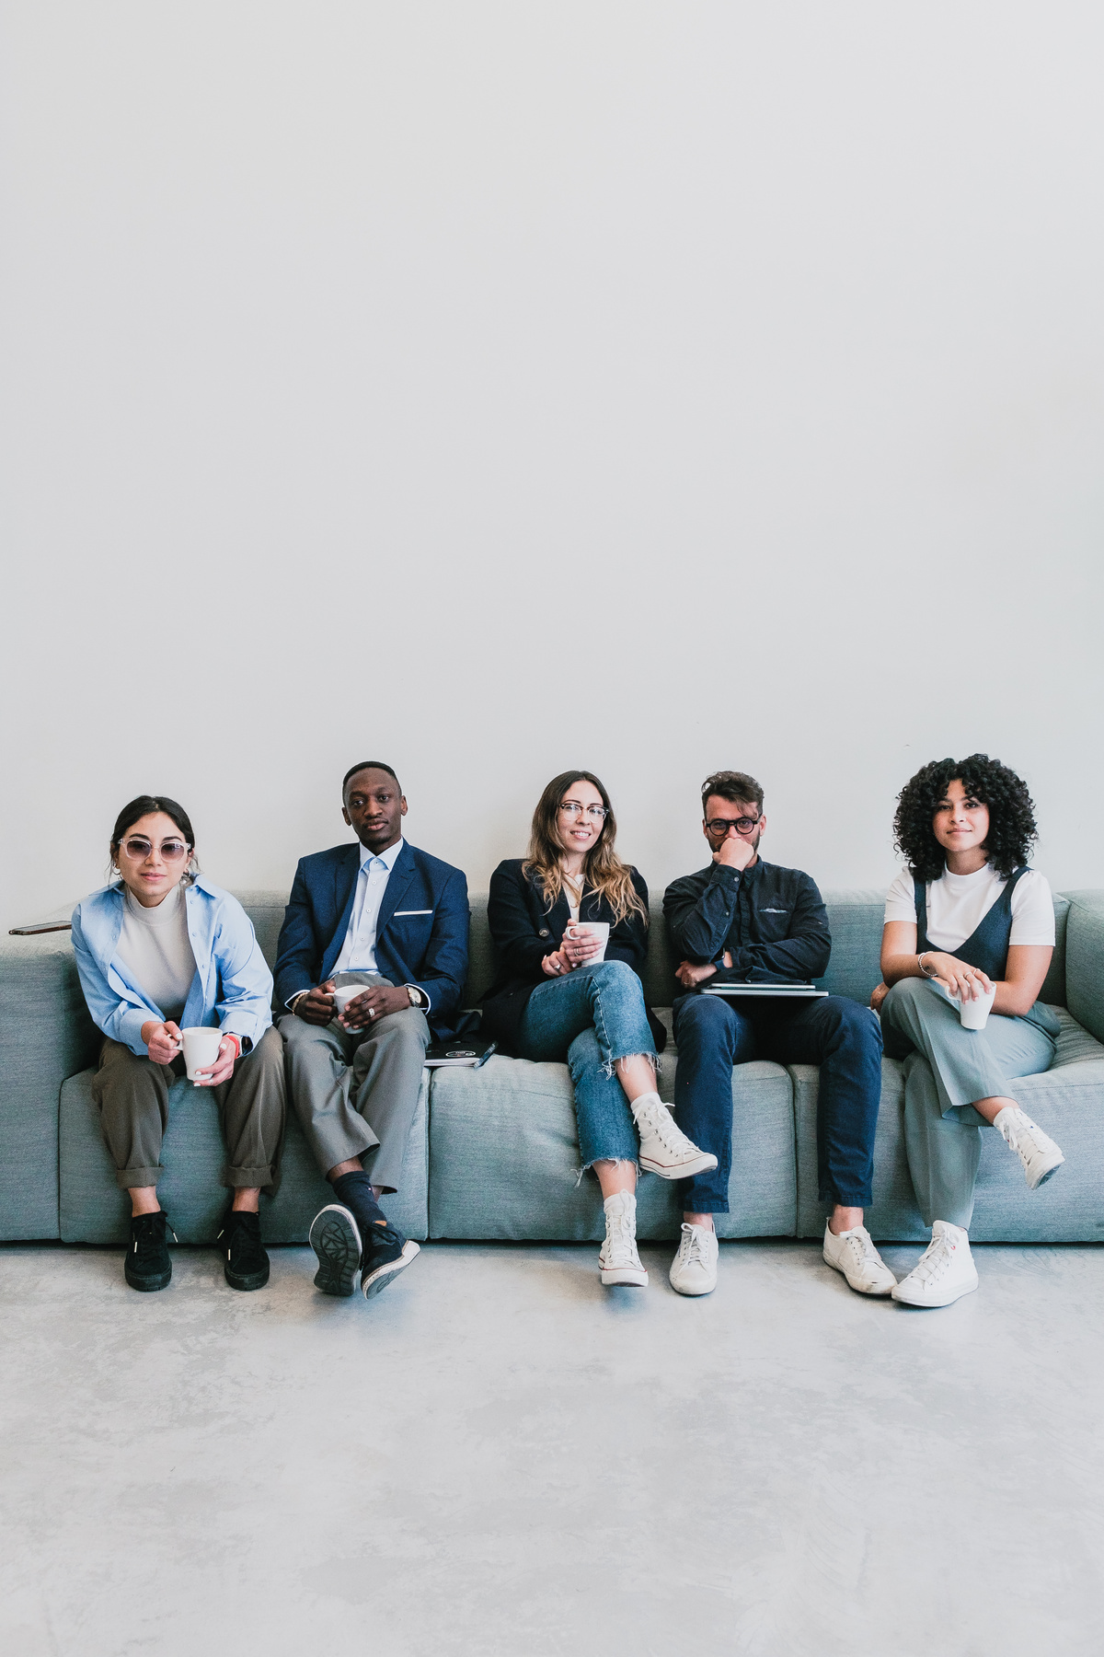
Q&A
Thank You!

